Slide 1



Slide 2

B+ Tree Definition
B+ Tree Properties
B+ Tree Searching
B+ Tree Insertion
B+ Tree Deletion

Slide 3

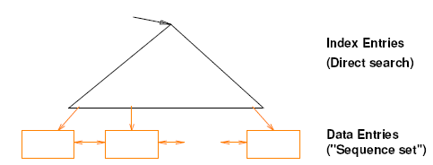
  B+Tree is The super index structure for disk-based databases
The B+ Tree index structure is the most widely used of several index structures that maintain their efficiency despite insertion and deletion of data.
Leaf pages are not allocated sequentially. They are linked together through pointers (a doubly linked list).

Slide 4

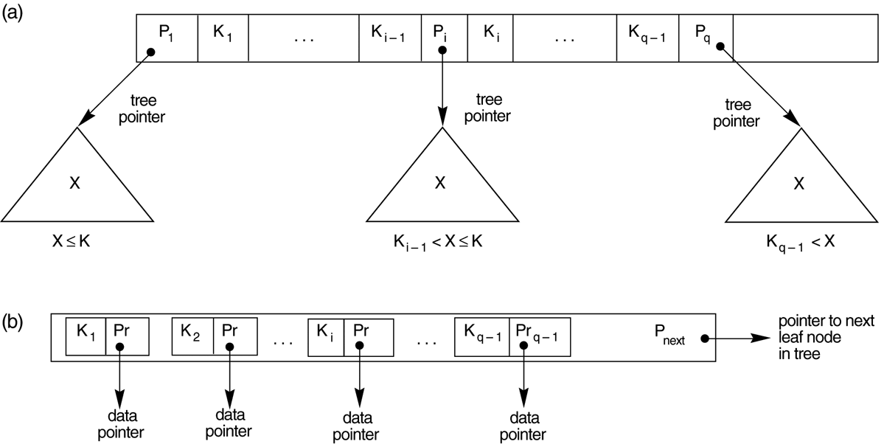
B+-Tree uses different nodes for leaf nodes and internal nodes
  Internal Nodes: Only unique keys and node links
    No data pointers!
  Leaf Nodes: Replicated keys with data pointer
    Data pointers only here

Slide 5

In a B-tree, pointers to data records exist at all levels of the tree
In a B+-tree, all pointers to data records exists at the leaf-level nodes
A B+-tree can have less levels (or higher capacity of search values) than the corresponding B-tree
The B+-Tree is an optimization of the B-Tree
  Improved traversal performance
  Increased search efficiency
  Increased memory efficiency

Slide 6

B+ Trees use a “fill factor” to control the growth and the shrinkage.
50% fill factor is the minimum for a B+ Tree.
For n=4, the following guidelines must be met:
Number of Keys/Page | 4
Number of Pointers/Page | 5
Fill Factor | 50%
Minimum Keys in each page | 2

Slide 7



Slide 8

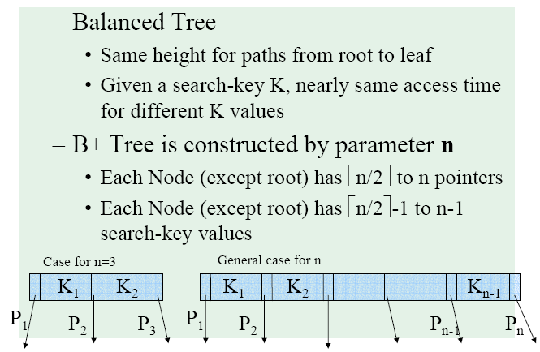

Slide 9

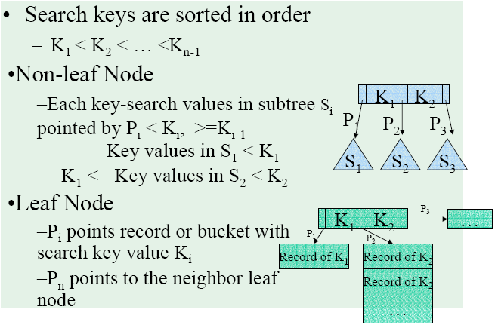

Slide 10
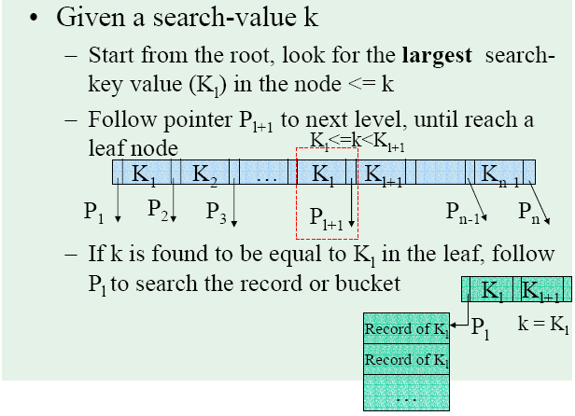

Slide 11

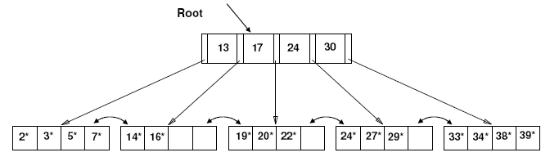
Search begins at root, and key comparisons direct it to a leaf. At each node, a binary search or linear search can be performed
Search for 5*, 15*, all data entries >= 24*
• Based on the search for 15*, we know it is not in the tree!

Slide 12

Find correct leaf L.
Put data entry onto L.
  If L has enough space, done!
  Else, must split L (into L and a new node L2)
    Redistribute entries evenly, copy up middle key.
    Insert index entry pointing to L2 into parent of L.
This can happen recursively
  To split index node, redistribute entries evenly, but push up middle key. (Contrast with leaf splits.)
Splits “grow” tree; root split increases height.
  Tree growth: gets wider or one level taller at top.

Slide 13

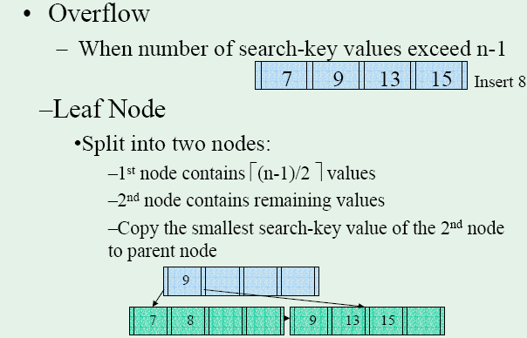

Slide 14
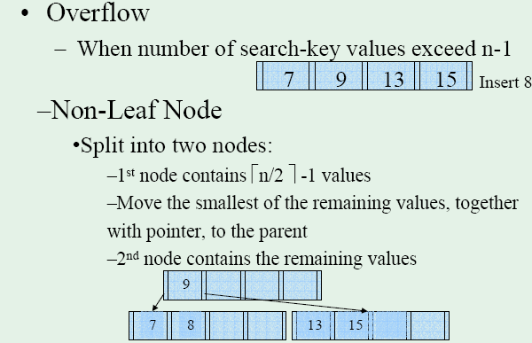

Slide 15

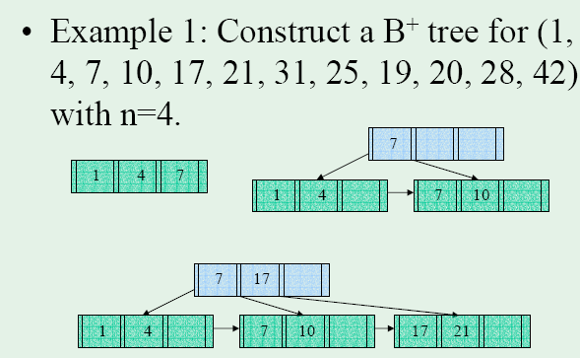

Slide 16

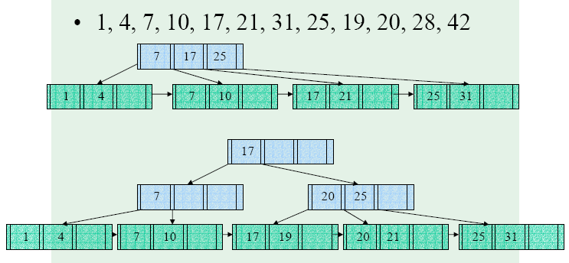

Slide 17
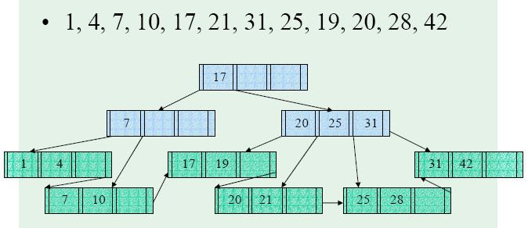

Slide 18

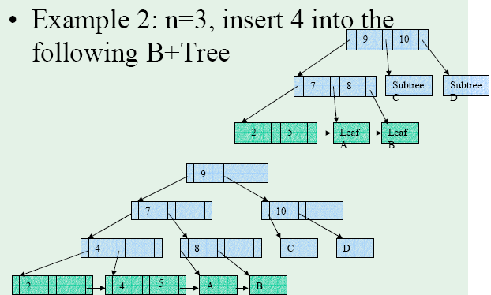

Internal
(push)

Slide 19
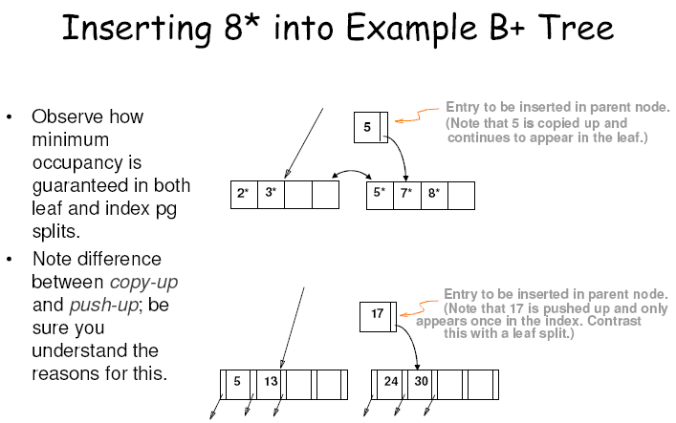

Slide 20
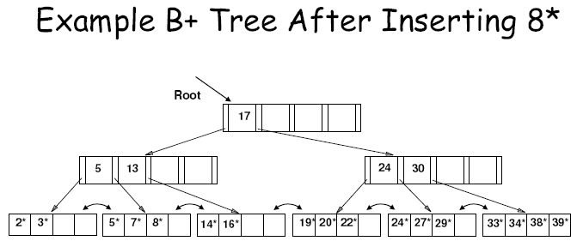
Notice that root was split, leading to increase in height.
In this example, we can avoid split by re-distributing entries; however, this is usually not done in practice.

Slide 21
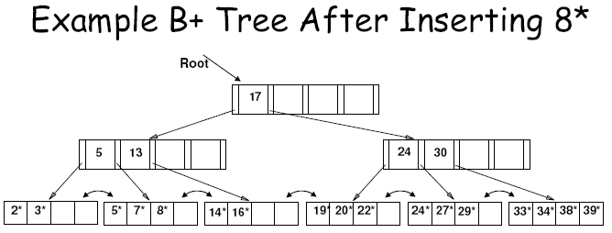
Notice that the value 5 occurs redundantly, once in a leaf page and once in a non-leaf page. This is because values in the leaf page cannot be pushed up, unlike the value 17

Slide 22

If a leaf node where insertion is to occur is full, fetch a neighbour node (left or right).
If neighbour node has space and same parent as full node, redistribute entries and adjust parent nodes accordingly
Otherwise, if neighbour nodes are full or have a different parent (i.e., not a sibling), then split as before.

Slide 23
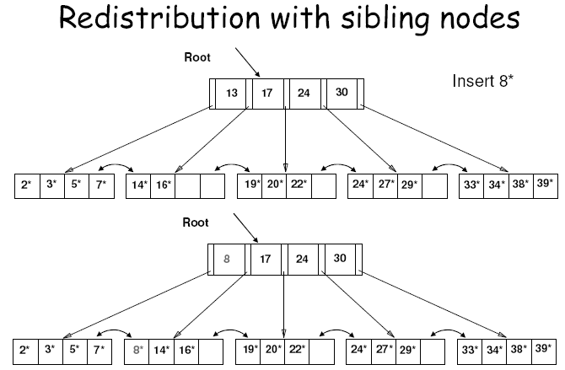

Slide 24

Start at root, find leaf L where entry belongs.
Remove the entry.
  If L is at least half-full, done!
  If L has only d-1 entries,
    Try to re-distribute, borrowing from sibling (adjacent node with same parent as L).
    If re-distribution fails, merge L and sibling.
If merge occurred, must delete entry (pointing to L or sibling) from parent of L.
Merge could propagate to root, decreasing height.

Slide 25

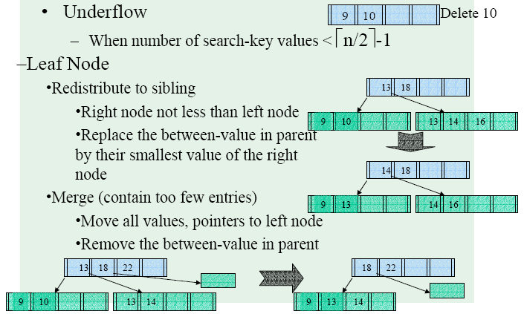

Slide 26

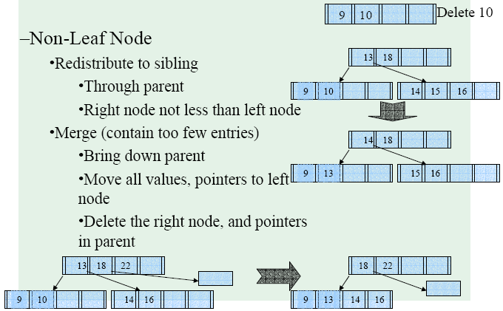

Slide 27

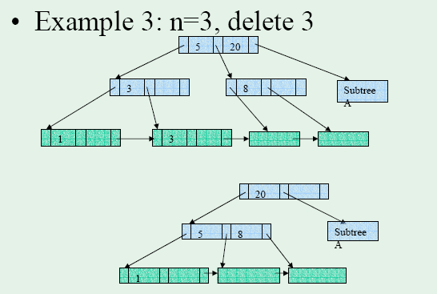

Slide 28

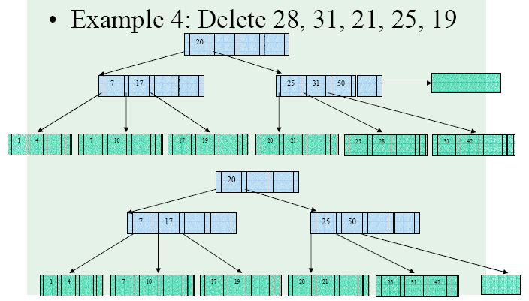

Slide 29
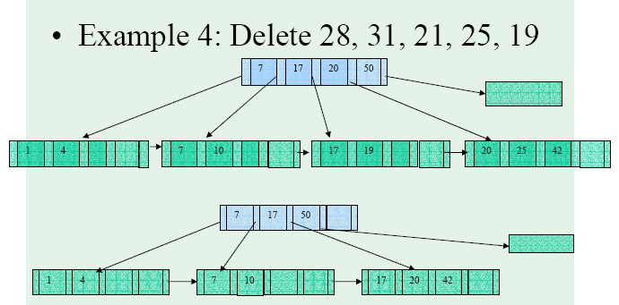

Slide 30
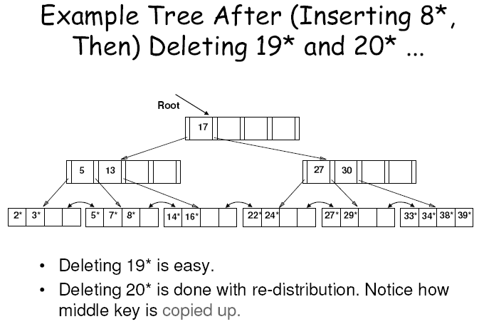

Slide 31
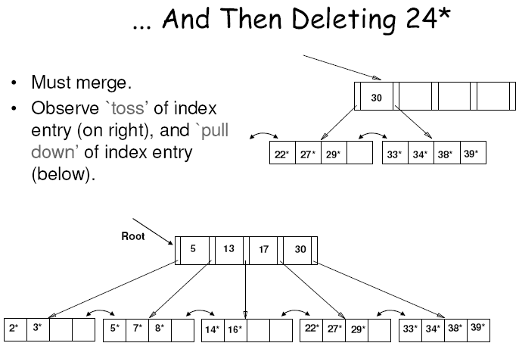

Slide 32

B Trees:
Multi-way trees
Dynamic growth
Contains only data pages
B+ Trees:
Contains features from B Trees
Contains index and data pages
Dynamic growth

Slide 33

Tree structured indexes are ideal for range-searches, also good for equality searches
B+ Tree is a dynamic structure
  Insertions and deletions leave tree height balanced
  High fanout means depth usually just 3 or 4
  Almost always better than maintaining a sorted file

